Slide 1
Module 3: Advanced SQL

Slide 2
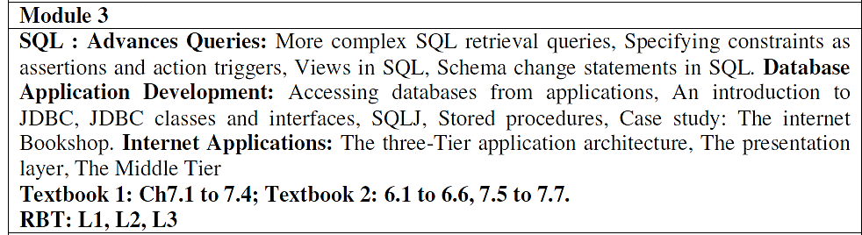
Module 3 Syllabus

Slide 3
Agenda
Nested Queries (in FROM clause)
Correlated Queries
Outer Joins (Left, Right, and Full)
Constraints as Assertions
PL/SQL Procedures
Triggers
Stored Procedures
Views in SQL
Embedded & Dynamic SQL

Slide 4
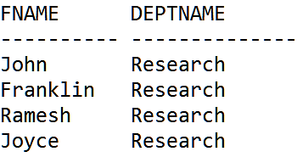
Nested Queries (in FROM clause)
Q1: Retrieve the name of each employee and name of the department, who works in department no. 5.
SELECT E.FNAME, TEMP.DEPTNAME
FROM EMPLOYEE E,
( SELECT DNUMBER AS DN, DNAME AS DEPTNAME
FROM DEPARTMENT WHERE DNUMBER = 5
) TEMP
WHERE E.DNO = TEMP.DN;

Slide 5
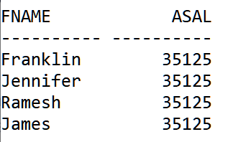
Nested Queries (in FROM clause)
Q2: Retrieve the name and salary of employees who draw more than the average salary of all employees.
SELECT E.FNAME, TEMP.ASAL
FROM EMPLOYEE E, (SELECT AVG(SALARY) AS ASAL FROM EMPLOYEE) TEMP
WHERE E.SALARY > TEMP.ASAL;

Slide 6
Correlated Queries
Query: Retrieve the name of each employee who has a dependent with the same first name and is the same sex as the employee.
SELECT E.Fname, E.Lname
FROM EMPLOYEE E
WHERE EXISTS (
SELECT *
FROM DEPENDENT D
WHERE E.Ssn=D.Essn
AND E.Sex=D.Sex
AND E.Fname=D.Dependent_name);

Slide 7
Correlated Queries…
Find names of sailors who’ve reserved boat #103
SELECT S.sname
FROM Sailors S
WHERE S.sid EXISTS
(SELECT *
FROM Reserves R
WHERE R.bid=103 AND S.sid=R.sid);
Correlation: subquery finds all reservations for bid 103 from current sid.
In case of correlation, subquery must be recomputed for each Sailors tuple.

Slide 8
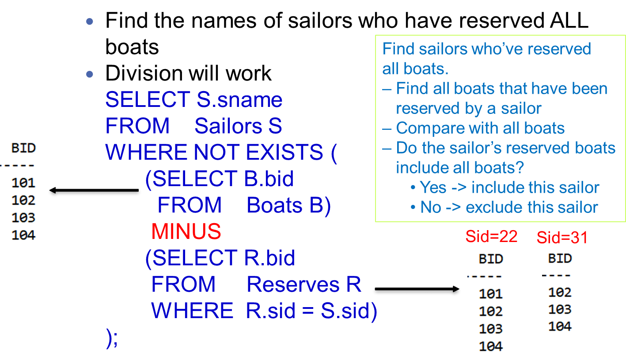
Division in SQL

Slide 9
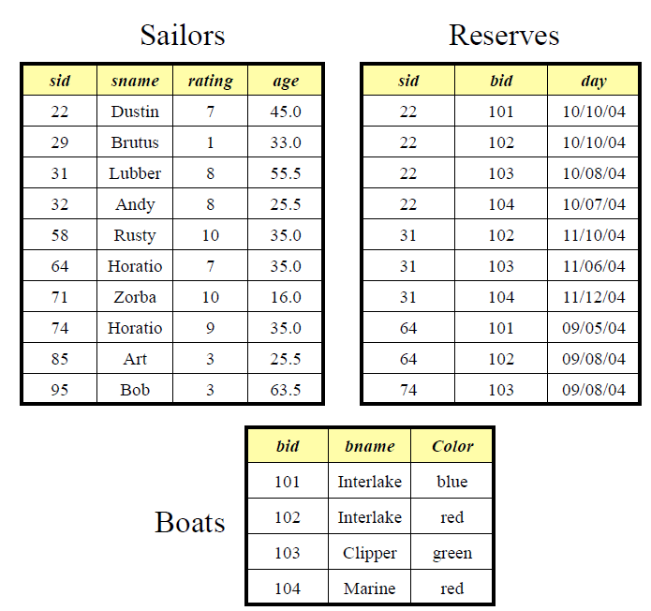

Slide 10
Method 2
SELECT S.sname
FROM Sailors S
WHERE NOT EXISTS
(SELECT B.bid
FROM Boats B
WHERE NOT EXISTS
(SELECT R.bid
FROM Reserves R
WHERE R.bid = B.bid AND R.sid = S.sid)
);

Slide 11
Exercises
Query: Write SQL query with and without EXISTS clause to find the total sales of southern region.
SELECT SUM(Sales) Ans: $2050
FROM Store WHERE EXISTS (SELECT *
FROM Location WHERE Region_name = ‘South’ AND Store.Store_name = Location.Store_name);
Store
Location
Store_name | Sales | Date
Chennai | 1500 | Jan-05-2017
Bangalore | 250 | Jan-07-2017
Chennai | 300 | Jan-08-2017
Delhi | 700 | Jan-08-2017
Region_name | Store_name
North | Delhi
South | Chennai
South | Bangalore
South | Hyderabad

Slide 12
Without EXISTS
SELECT SUM(Sales)
FROM Store
WHERE Store_name IN
(SELECT Store_name
FROM Location
WHERE Region_name = 'South');
SELECT SUM(Sales)
FROM Store S, Location L
WHERE S.Store_name = L.Store_name AND L.Region_name = 'South';

Slide 13
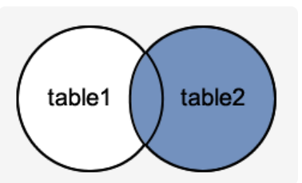
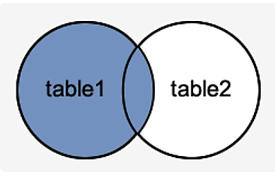
OUTER JOINS
Right Outer Join
SELECT table1.column, table2.column
FROM table1 t1, table2 t2
WHERE t1.column(+) = t2.column;
Left Outer Join
SELECT table1.column, table2.column
FROM table1 t1, table2 t2
WHERE t1.column = t2.column(+);

Slide 14
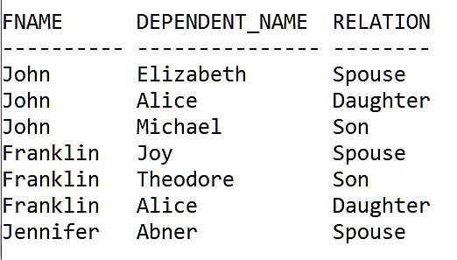
RIGHT OUTER JOINS
SELECT E.FNAME, D. DEPENDENT_NAME, D.RELATIONSHIP
FROM EMPLOYEE E, DEPENDENT D
WHERE E.SSN(+) = D.ESSN;

Slide 15
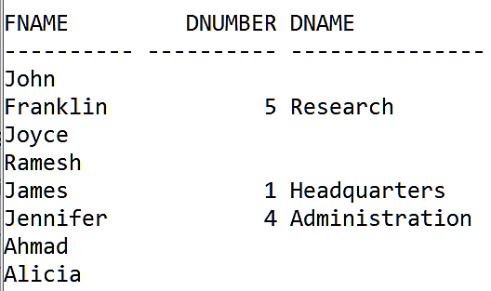
LEFT OUTER JOINS
SELECT E.FNAME, D.DNUMBER, D.DNAME
FROM EMPLOYEE E, DEPARTMENT D
WHERE E.SSN = D.MGR_SSN(+);
Manager details with all employees:

Slide 16
Constraints as Assertions
In SQL, we can specify general constraints—those that do not fall into any of the built-in categories such as Primary key, Foreign key, Unique, Not Null, etc. (called as entity integrity constraints)
Each assertion is given a constraint name and is specified via a condition similar to the WHERE clause of an SQL query.
Example: to specify the constraint that the salary of an employee must not be greater than the salary of the manager of the department that the employee works for in SQL.
Assertion is not supported in Oracle.

Slide 17
SQL Code
CREATE ASSERTION SALARY_CONSTRAINT
CHECK (
NOT EXISTS (
SELECT *
FROM EMPLOYEE E, EMPLOYEE M, DEPARTMENT D
WHERE E.Salary > M.Salary AND
E.Dno = D.Dnumber AND D.Mgr_ssn=M.Ssn
)
);

Slide 18
PL/SQL PROCEDURE
Syntax
CREATE OR REPLACE PROCEDURE
<procedure_name>
(
<parameterl IN/OUT <datatype>
..
.
)
[ IS | AS ]
<declaration_part>
BEGIN
<execution part>
EXCEPTION
<exception handling part>
END;

Slide 19
PL/SQL PROCEDURE…
The oracle 11g SQL *Plus is an interactive, command-line driven SQL interface to the Oracle database
PL/SQL is almost similar to normal third generation languages with variable declarations, control structures, exception handling, and modularization
Example
CREATE TABLE AREAS (
RADIUS INTEGER,
AREA FLOAT
);

Slide 20
EXAMPLE
CREATE OR REPLACE PROCEDURE FIND_AREA AS
BEGIN
DECLARE
pi constant NUMBER(9,7) := 3.1415;
radius INTEGER(5);
area NUMBER(14,2);
BEGIN
radius := 3;
area := pi * power(radius, 2);
INSERT INTO Areas values (radius, area);
END;
END;
/
SQL> EXEC FIND_AREA;

Slide 21
PL/SQL PROCEDURE-WITH PARAMETR
CREATE OR REPLACE PROCEDURE
FIND_AREA (RADIUS IN INTEGER) AS
BEGIN
DECLARE
pi constant NUMBER(9,7) := 3.1415;
area NUMBER(14,2);
BEGIN
area := pi * power(radius, 2);
INSERT INTO Areas values (radius, area);
END;
END;
/

Slide 22
IN/OUT PARAMETER
DECLARE
n number;
PROCEDURE squareNum(x IN OUT number) IS
BEGIN
x := x * x;
END;
BEGIN
n:= 23;
squareNum(n);
dbms_output.put_line(' Square of (23): ' || n);
END;
/

Slide 23
Triggers
A trigger is one which defines an action that the database should take when some event occurs in the application
This would be useful for taking action against some violations of integrity constraints
The trigger body is made up of a PL/SQL block, a Java program, or a C program
There are two types of triggers
row-level triggers and
statement-level triggers.
The row-level triggers execute once for each row in a transaction and the statement-level trigger execute once for each transaction.

Slide 24
Triggers…
The CREATE TRIGGER statement creates or replaces a database trigger, which is either of these:
A stored PL/SQL block associated with a table, a schema, or the database
An anonymous PL/SQL block or an invocation of a procedure implemented in PL/SQL or Java
The database automatically runs a trigger when specified conditions occur.
Example:
CREATE TABLE Emp_log (
Emp_id NUMBER,
Log_date DATE,
New_salary NUMBER,
Action VARCHAR2(20));
create table employees(
emp_id NUMBER,
salary FLOAT,
addr VARCHAR2(20),
constraint pke primary key(emp_id));

Slide 25
Example…
CREATE OR REPLACE TRIGGER log_salary_increase
AFTER UPDATE OF salary ON employees
FOR EACH ROW
BEGIN
INSERT INTO Emp_log (Emp_id, Log_date, New_salary, Action)
VALUES (:NEW.emp_id, SYSDATE, :NEW.salary, 'Salary hiked');
END;
/
SQL> UPDATE employees SET salary = salary + 1000.0;

Slide 26
Stored Procedures
A stored procedure is a PL/SQL block which performs a specific task or a set of tasks.
It contains one or more SQL statements
Advantages
Create reusable, discrete pieces of functionality
If you have a stored procedure that manipulates large amounts of data, that data will remain on the server and not be transported across the network
Useful for security
Grant users execute permissions on stored procedures without granting them permissions on objects manipulated by those stored procedures

Slide 27
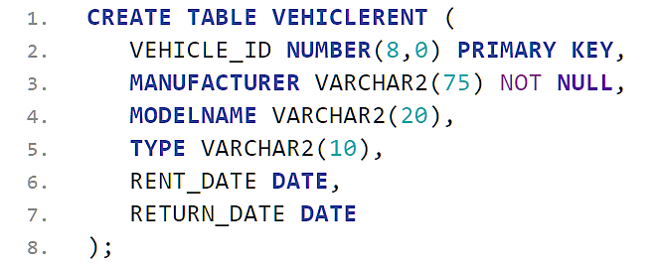
Example
A vehicle is rented on a daily charge basis. Suppose total rent needs to be calculated based on its rented and return dates using a procedure.
INSERT INTO VEHICLERENT VALUES(1, 'Honda', 'City', 'Car',TO_DATE('2018-02-20','YYYY-MM-DD'),
TO_DATE('2018-02-23','YYYY-MM-DD'));
INSERT INTO VEHICLERENT VALUES(2, 'Hyundai', 'i20', ‘Car',TO_DATE('2018-03-10','YYYY-MM-DD'), TO_DATE('2018-03-13','YYYY-MM-DD'));

Slide 28
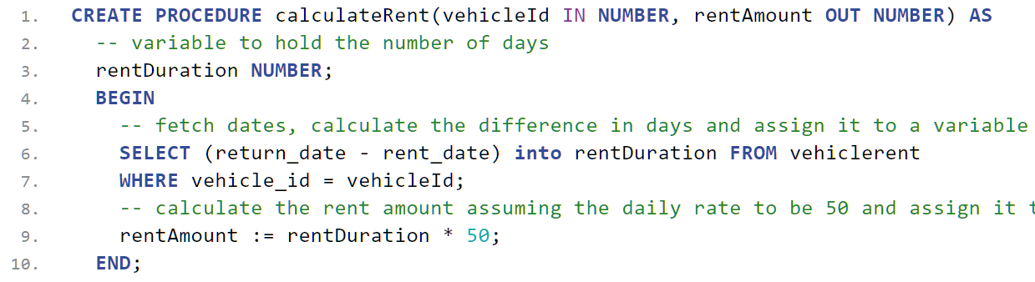
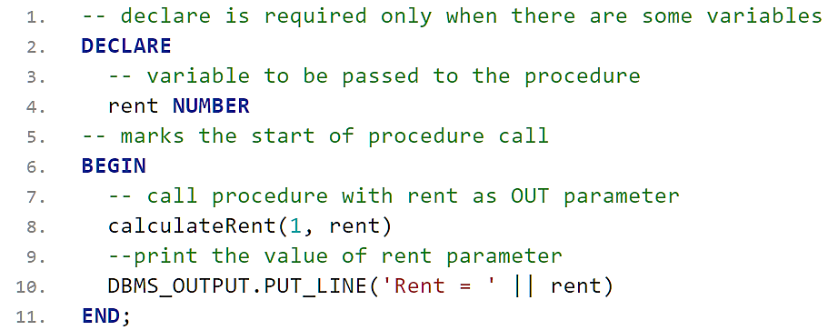
Example…

Slide 29
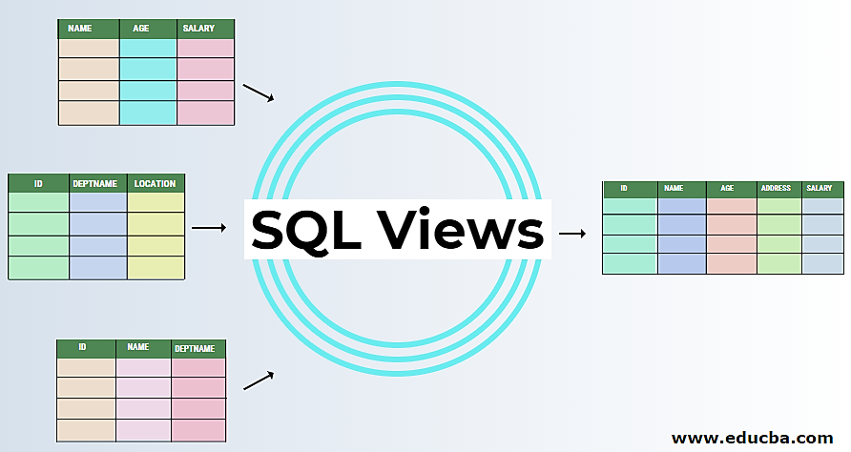
Views in SQL
A view in SQL terminology is a single table that is derived from other tables.
These other tables can be base tables or previously defined views.
Views are considered to be a virtual table, in contrast to base tables, whose tuples are always physically stored in the database.

Slide 30
Specification of Views in SQL
In SQL, the command to specify a view is CREATE VIEW.
The view is given a (virtual) table name (or view name), a list of attribute names, and a query to specify the contents of the view
V1: CREATE VIEW WORKS_ON1 AS
SELECT Fname, Lname, Pname, Hours
FROM EMPLOYEE, PROJECT, WORKS_ON
WHERE Ssn=Essn AND Pno=Pnumber;
CREATE VIEW DEPT_INFO(Dept_name, No_of_emps, Total_sal) AS
SELECT Dname, COUNT (*), SUM (Salary)
FROM DEPARTMENT, EMPLOYEE
WHERE Dnumber=Dno
GROUP BY Dname;

Slide 31
DML Operations on Views
A user can always issue a retrieval query against any view.
However, issuing an INSERT, DELETE, or UPDATE command on a view table is in many cases not possible.
A view with a single defining table is updatable if the view attributes contain the primary key of the base relation, as well as all attributes with the NOT NULL constraint that do not have default values specified.
Views defined on multiple tables using joins are generally not updatable.
Views defined using grouping and aggregate functions are not updatable.

Slide 32
Example 1
UV1: UPDATE WORKS_ON1
SET Pname = ‘ProductY’
WHERE Lname = ‘Smith’ AND Fname = ‘John’ AND Pname = ‘ProductX’;
This query can be mapped into several updates on the base relations to give the desired update effect on the view.

Slide 33
Example 2
CREATE OR REPLACE VIEW EMPDEPT AS
SELECT SSN, FNAME, DNAME
FROM EMPLOYEE, DEPARTMENT
WHERE DNO = DNUMBER;
UPDATE EMPDEPT
SET DNAME='Administration'
WHERE SSN='123456789';
ERROR at line 2:
ORA-01779: cannot modify a column which maps to a non key-preserved table

Slide 34
Database Application Development

Slide 35
Concept of JDBC
Accessing popular DBMS by writing Java code.
Think of a database as just another device connected to your computer.
Like other devices, it has a driver program to relieves you of having to do low level programming to use the database.
The driver provides you with a high level API to the database.
The JDBC driver translates the routine into low-level messages that are understood and processed by the DBMS.

Slide 36
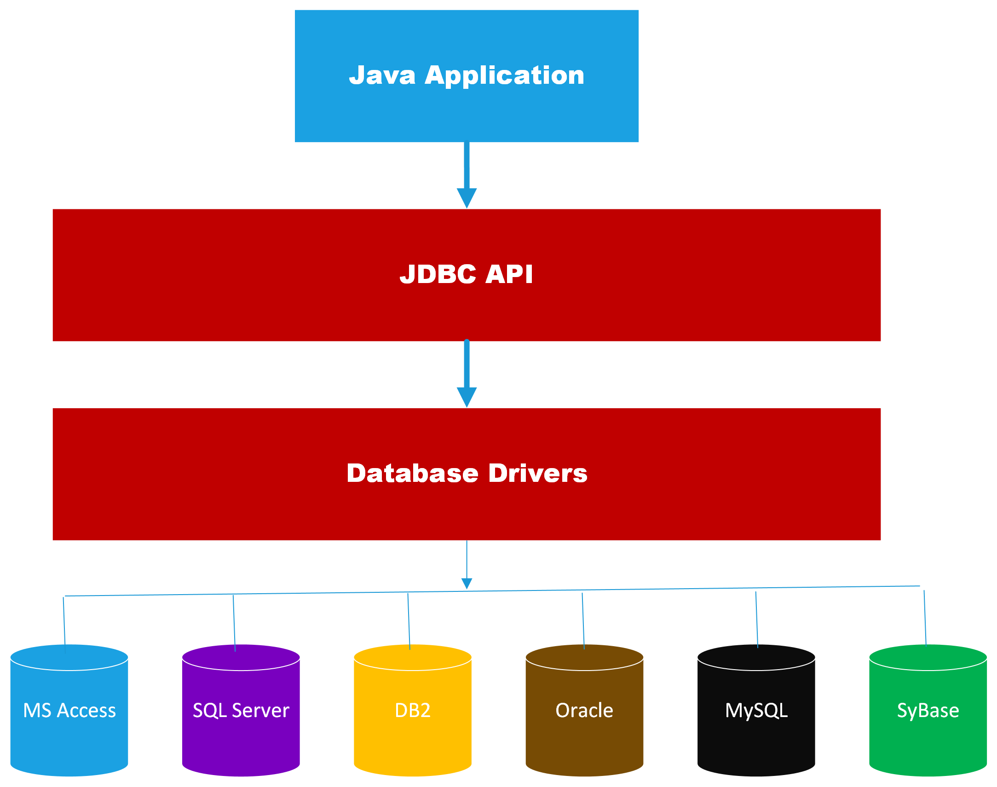
JDBC Architecture

Slide 37
JDBC Driver Types
Type 1: JDBC-ODBC bridge
JDBC-ODBC Bridge Driver
Type 2: Native-API driver
Java Native API, partially java
Type 3: Network-Protocol driver
JDBC Network Driver, partially java
Type 4: Pure Java Driver
100% Java

Slide 38
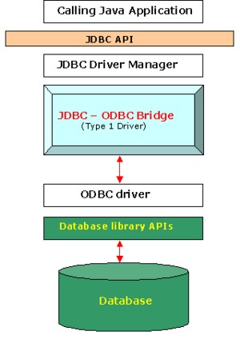
Type 1 : JDBC-ODBC bridge
Translate JDBC into ODBC and use Windows ODBC built in drivers
ODBC must be set up on every client
driver must be physically on each machine for both java applications and applets
for server side servlets ODBC must be set up on web server

Slide 39
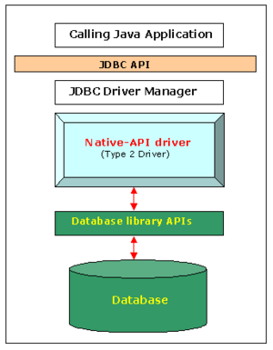
Type 2 : Native-API driver
The JDBC type 2 driver, also known as the Native-API driver, is a database driver implementation that uses the client-side libraries of the database.
The driver converts JDBC method calls into native calls of the database API.
For example: Oracle OCI driver is a type 2 driver.
It is faster.

Slide 40
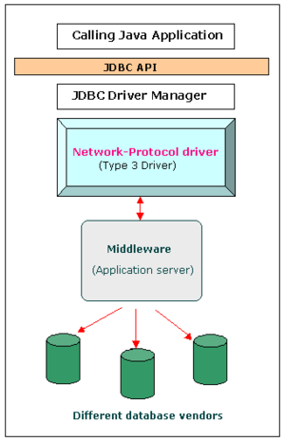
Type 3 : Network-Protocol driver
The JDBC type 3 driver, also known as the Pure Java driver for database middleware, is a database driver implementation which makes use of a middle tier between the calling program and the database.
The middle-tier (application server) converts JDBC calls directly or indirectly into a vendor-specific database protocol

Slide 41
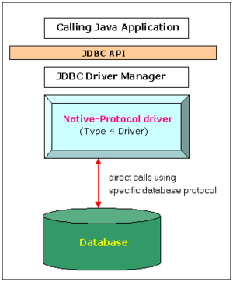
Type 4 : Pure Java driver
This driver converts JDBC calls directly into a vendor- specific database protocol.
Written completely in Java, type 4 drivers are thus platform independent.
They install inside the Java virtual machine of the client.
This provides better performance than the type 1 and type 2 drivers.

Slide 42
JDBC Process
Loading the JDBC Driver.
Connecting to the DBMS.
Creating and executing the Statement.
Processing the data returned by the DBMS.
Terminating the DBMS connection object.

Slide 43
Connect to DBMS
String user = "scott";
String password = "tiger";
Connection con =
DriverManager.getConnection(url, user, password);
java.sql.DriverManager class is responsible for managing the driver information.

Slide 44
Create DBMS Table
CREATE TABLE Customers (
custid integer primary key,
custname varchar2(20),
Balance float
);
INSERT INTO CUSTOMERS VALUES(111,'SCOTT',2000);
INSERT INTO CUSTOMERS VALUES(222,'ALLEN',4000);
INSERT INTO CUSTOMERS VALUES(333,'SOWMYA',3200);
D:\Dropbox\DBMS PPTs\JDBC Demo\JDBCDemo

Slide 45
Create & Execute SQL Stmt.
Connection con = DriverManager.getConnection("jdbc:oracle: thin:@localhost:1521:orcl", user, password);
Statement stmt = con.createStatement( );
ResultSet rs = stmt.executeQuery("Select * from Customers");
ResultSet object is used to interact with data returned by DBMS to the J2EE component.

Slide 46
Process Data returned by DBMS
String cid;
String cname;
double cbal;
while (rs.next()) {
cid = rs.getString("CustID");
cname = rs.getString("CustName");
cbal = rs.getDouble("Balance");
System.out.println(cid + "\t" + cname + "\t" + cbal);
}

Slide 47
Terminate the Connection
rs.close();

Slide 48
Java Program in Netbeans IDE 8.0.2
package jdbcdemo;
import java.sql.*;
public class JDBCDemo {
public static void main(String[] args) {
try {
System.out.println("Welcome to JDBC Demo");
Class.forName("oracle.jdbc.driver.OracleDriver");
} catch (ClassNotFoundException e) {
System.out.println("Driver problem");
}
String user = "scott";
String password = "tiger";
try {
Connection con = DriverManager.getConnection(
"jdbc:oracle:thin:@localhost:1521:orcl", user, password);
Statement stmt = con.createStatement();
System.out.println("Successfully connected to Oracle Database");

Slide 49
ResultSet rs = stmt.executeQuery("Select * from Customers");
String cid;
String cname;
double cbal;
while (rs.next()) {
cid = rs.getString("CustID");
cname = rs.getString("CustName");
cbal = rs.getDouble("Balance");
System.out.println(cid + "\t" + cname + "\t" + cbal);
}
}
catch (Exception e) {
e.printStackTrace();
}
}
}

Slide 50
Add Customer Amount
double total = 0;
String cid;
String cname;
double cbal;
while (rs.next()) {
cid = rs.getString("CustID");
cname = rs.getString("CustName");
cbal = rs.getDouble("Balance");
System.out.println(cid+"\t"+cname+"\t"+cbal);
total += cbal;
}

Slide 51
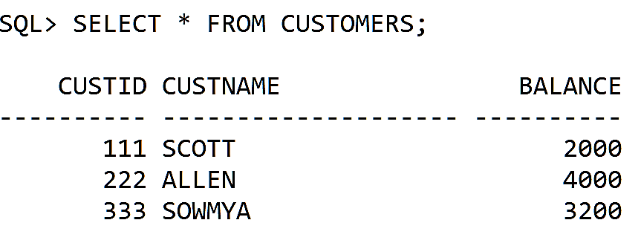
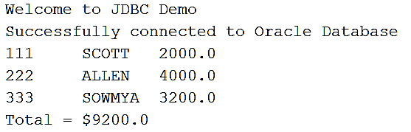
Input & Output
Customer Table

Slide 52
Insert a New Customer
package jdbcdemo;
import java.sql.*;
public class AddCustomer {
public static void Display(Connection con){
try {
Statement stmt = con.createStatement();
Integer id;
String name;
double bal;
// Customer Data
id = 666; name = "Kiran"; bal = 345;
// SQL
String sql = "Insert into Customers values(" + id + "," + "'" + name + "'" + "," + bal + ")" ;
stmt.executeQuery(sql);
con.commit();
}
catch(Exception e)
{System.out.println("ERROR\n");}
}
}

Slide 53
Embedded SQL
SQL statements are embedded directly into the program source code and mixed with the host languages (C, C#, Java, Python, etc.)
Static Embedded SQL
Dynamic Embedded SQL
EXEC SQL INSERT INTO Employee VALUES (1111,'Scott',3456.89);
To retrieve a single row from a table, we use
EXEC SQL SELECT SSN, Name, Salary
INTO :hSSN, :hName, :hSalary
FROM Employee
WHERE SSN = 1111;
Host Variable

Slide 54
Database Web Application Development Customer Database

Slide 55
DB Application Development using Python 3 & Anvil Cloud
Software Tools
Python 3.10 (https://www.python.org/downloads/)
Visual Studio Code 2019 (v1.62)
https://visualstudio.microsoft.com/downloads/
Anvil Works Framework (No installation required)
https://anvil.works/build
Database
MySQL Installer (MySQL Workbench 8.0.27
+MySQL Server+Connectors)
https://dev.mysql.com/downloads/installer/

Slide 56
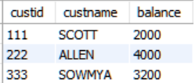
Problem Statement
Retrieve information about a single customer from the “Customers” table.
Assume that the table is created using MySQL Workbench DB.
The customer ID will be passed as a parameter from the application and the details will be displayed in an Anvil form.

Slide 57
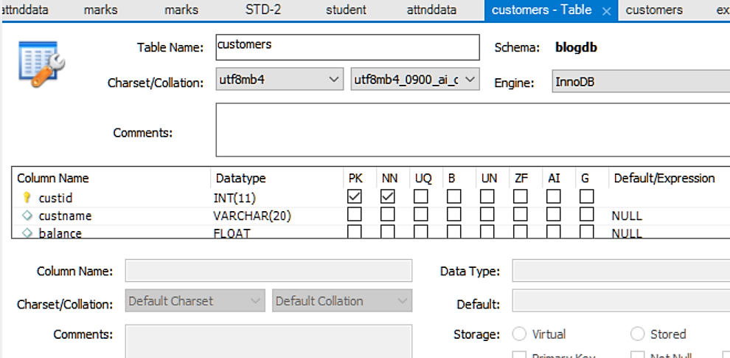
Step 1. Create Customers Table in MySQL

Slide 58
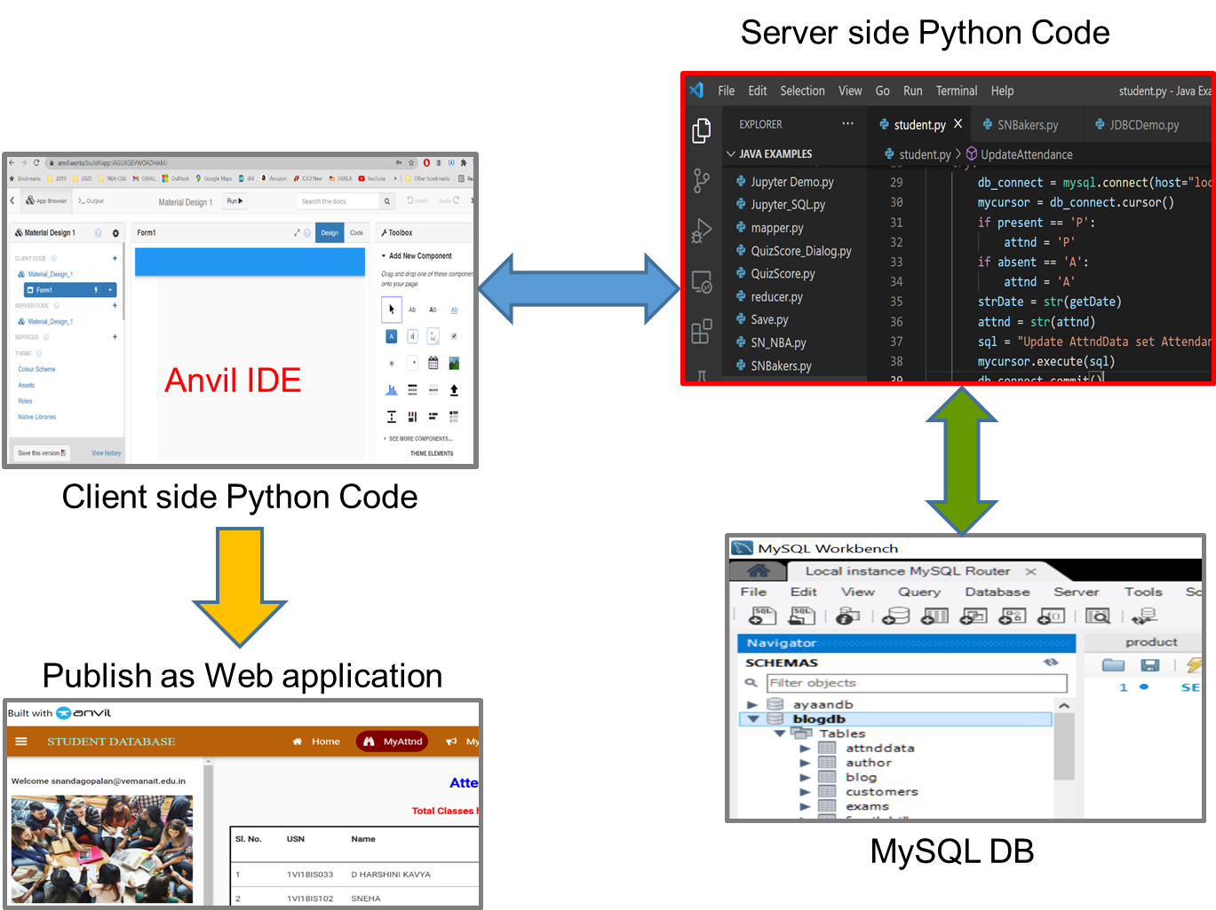
Design Flow

Slide 59
Step 2. Type the Python Code in VS Code 2019
# File name: JDBCDemo.py
import anvil.server
import mysql.connector as mysql
import numpy as np
def CallAnvil():
anvil.server.connect("KOYVGRXKV4G7Z SIJYHMHO75V-B4IY4TYF37ZNHGAV")
anvil.server.wait_forever()

Slide 60
Contd.
@anvil.server.callable
def GetCustomerInfo(id):
try:
db_connect =
mysql.connect(host="localhost",database="blogdb",
user ="root", passwd="admin", use_pure=True)
sql = "SELECT custid, custname, balance
FROM Customers
WHERE custid = " + id
mycursor = db_connect.cursor()
mycursor.execute(sql)
cust_data = mycursor.fetchall()
return cust_data
except Exception as err:
print(err)
return err
CallAnvil()

Slide 61
Step 3. Create the application in Anvil
In the browser type the URL of Anvil Works
Select “New Blank App”
Select “Material Design” template
You can rename your default form to “Home”
Drag and drop the following from the side panel “Add New Component”:
Labels for Customer ID entry and a Text box
For the output drop six labels – Customer id, customer name, and balance (2 for each)
Finally, create a button and modify its text as “Submit”

Slide 62
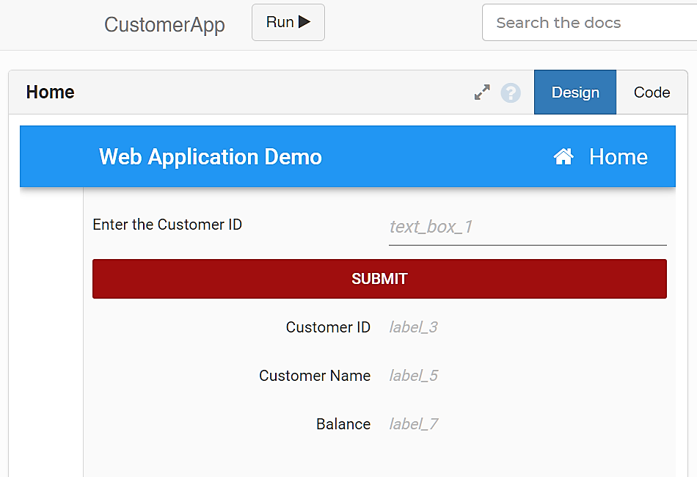
Snapshot of Home form

Slide 63
Step 4. Coding in the Frontend
Double click the Submit button component to type the code in Python
def button_1_click(self, **event_args):
id = self.text_box_1.text
cust_data =
anvil.server.call('GetCustomerInfo',id)
if len(cust_data) == 0:
alert('Customer Data Not found')
else:
self.label_3.text = cust_data[0][0]
self.label_5.text = cust_data[0][1]
self.label_7.text = cust_data[0][2]

Slide 64
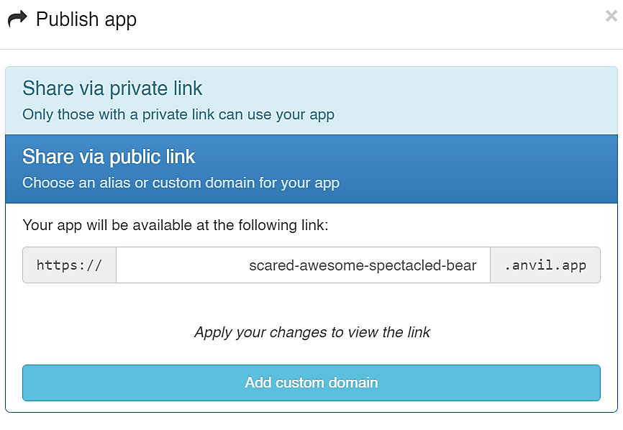
Step 5. Publish in Cloud
Click the Gear icon and select “Publish”
Click “Share via Public link”
Give a name to your application – say customer.anvil.app
Click Apply and OK

Slide 65
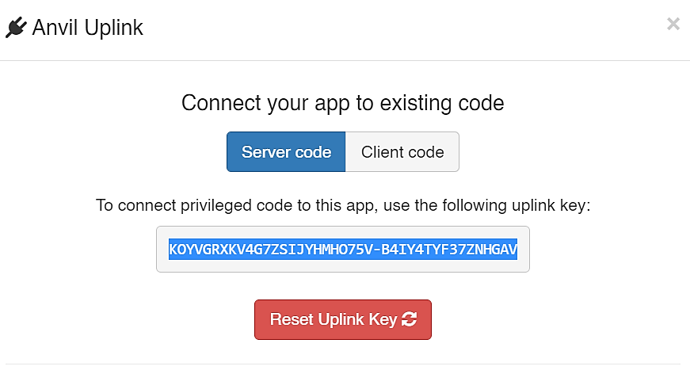
Step 5. Linking
Go to settings (gear icon) and select “Uplink”
When you enable the server code you can see the key. Copy and paste it to the server side Python code.
Click Run button to execute your app

Slide 66
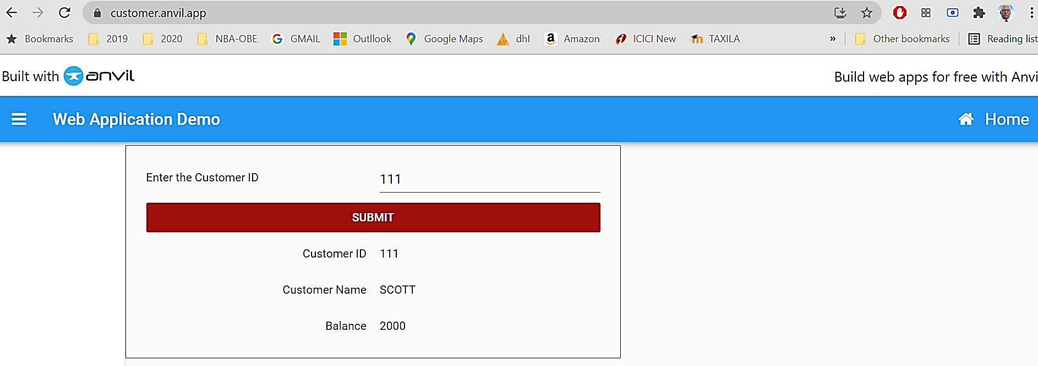
Step 6. Check your app in the Browser
https://customer.anvil.app

Slide 67
Summary

